Slide 1
Music Recommendation System
PRESENTED BY:
NAME | ROLL NO
Kanwardeep Singh | 2210990473
Kanwarjeet Singh | 2210990474
Jaskirat Singh Maan | 2210990445
Under the supervision of
Mrs.Shagun Sharma
Chitkara University Institute of Engineering and Technology
Chitkara University, Punjab

Slide 2
Overview
OVERVIEW
INTRODUCTION
METHODLOGY
CODE SNIPPETS
CONCLUSION
REFERENCES

Slide 3
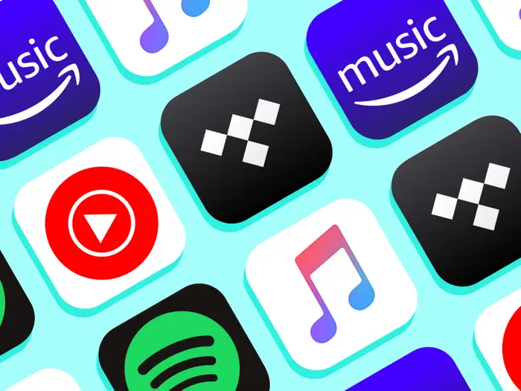
INTRODUCTION
"In today's digital world, recommendation systems play a crucial role in shaping our online experiences, from suggesting videos and music to recommending products. Our innovative algorithm combines content-based and collaborative filtering techniques to provide accurate and personalized recommendations, leveraging user preferences and historical data. Powered by deep learning, our system offers curated selections and playlist continuation, akin to Spotify's Discover Weekly Playlist. We're dedicated to enhancing user experiences and fostering deeper connections with digital content."

Slide 4
METHODLOGY
"Our music recommendation system starts with collecting and preprocessing data from various sources, extracting key features like genre and artist. Exploratory data analysis helps us understand the data, guiding our choice of machine learning algorithms like collaborative or content-based filtering. We train models using Python libraries, focusing on optimizing performance metrics. Our hybrid approach combines user preferences with historical data for personalized recommendations. Real-time processing and deployment via Flask or FastAPI on cloud platforms ensure responsiveness. Continuous evaluation through A/B testing and user feedback drives iterative improvements, aiming for a personalized and engaging music listening experience."

Slide 5
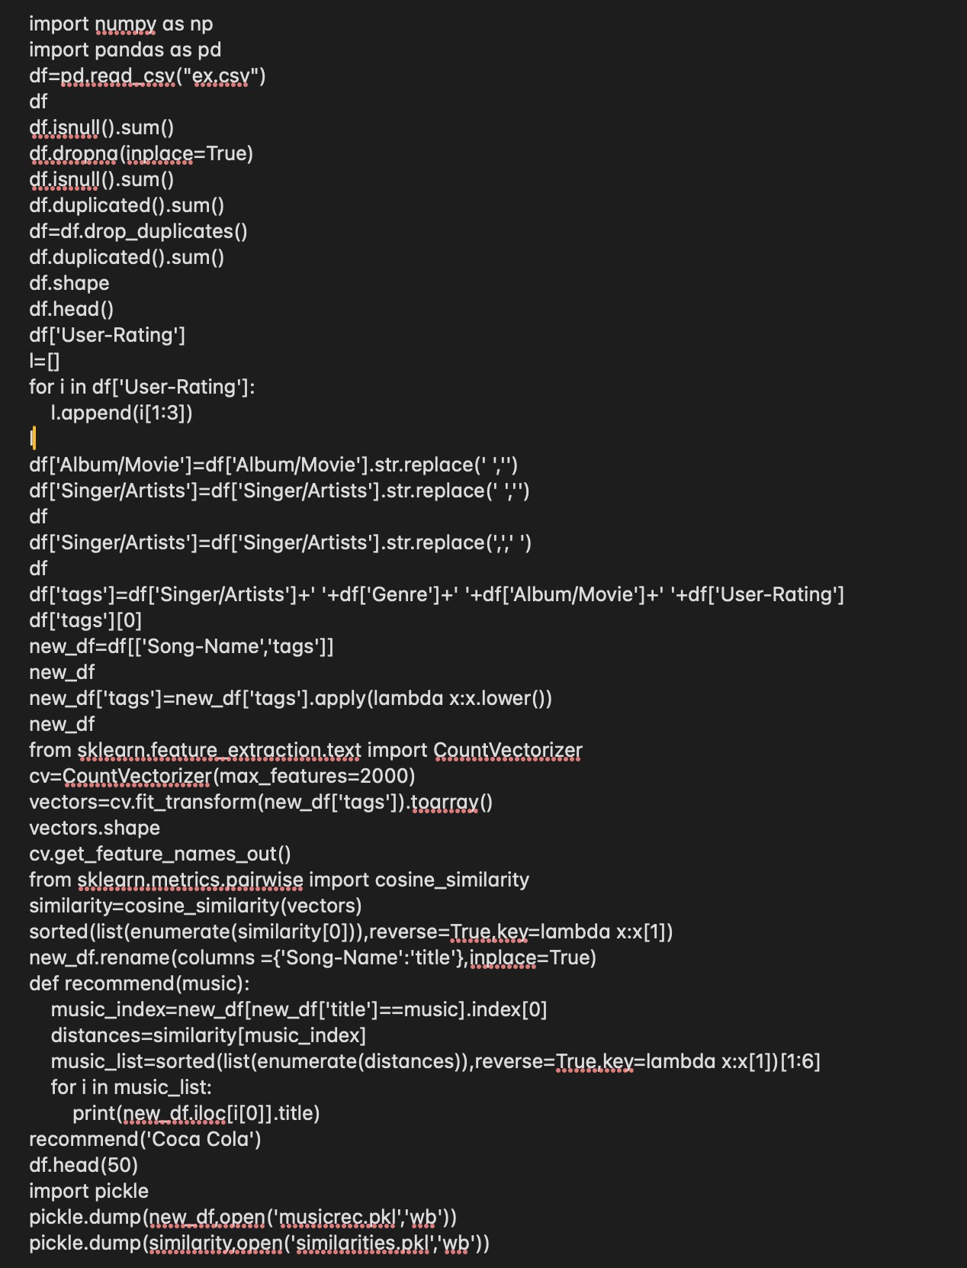
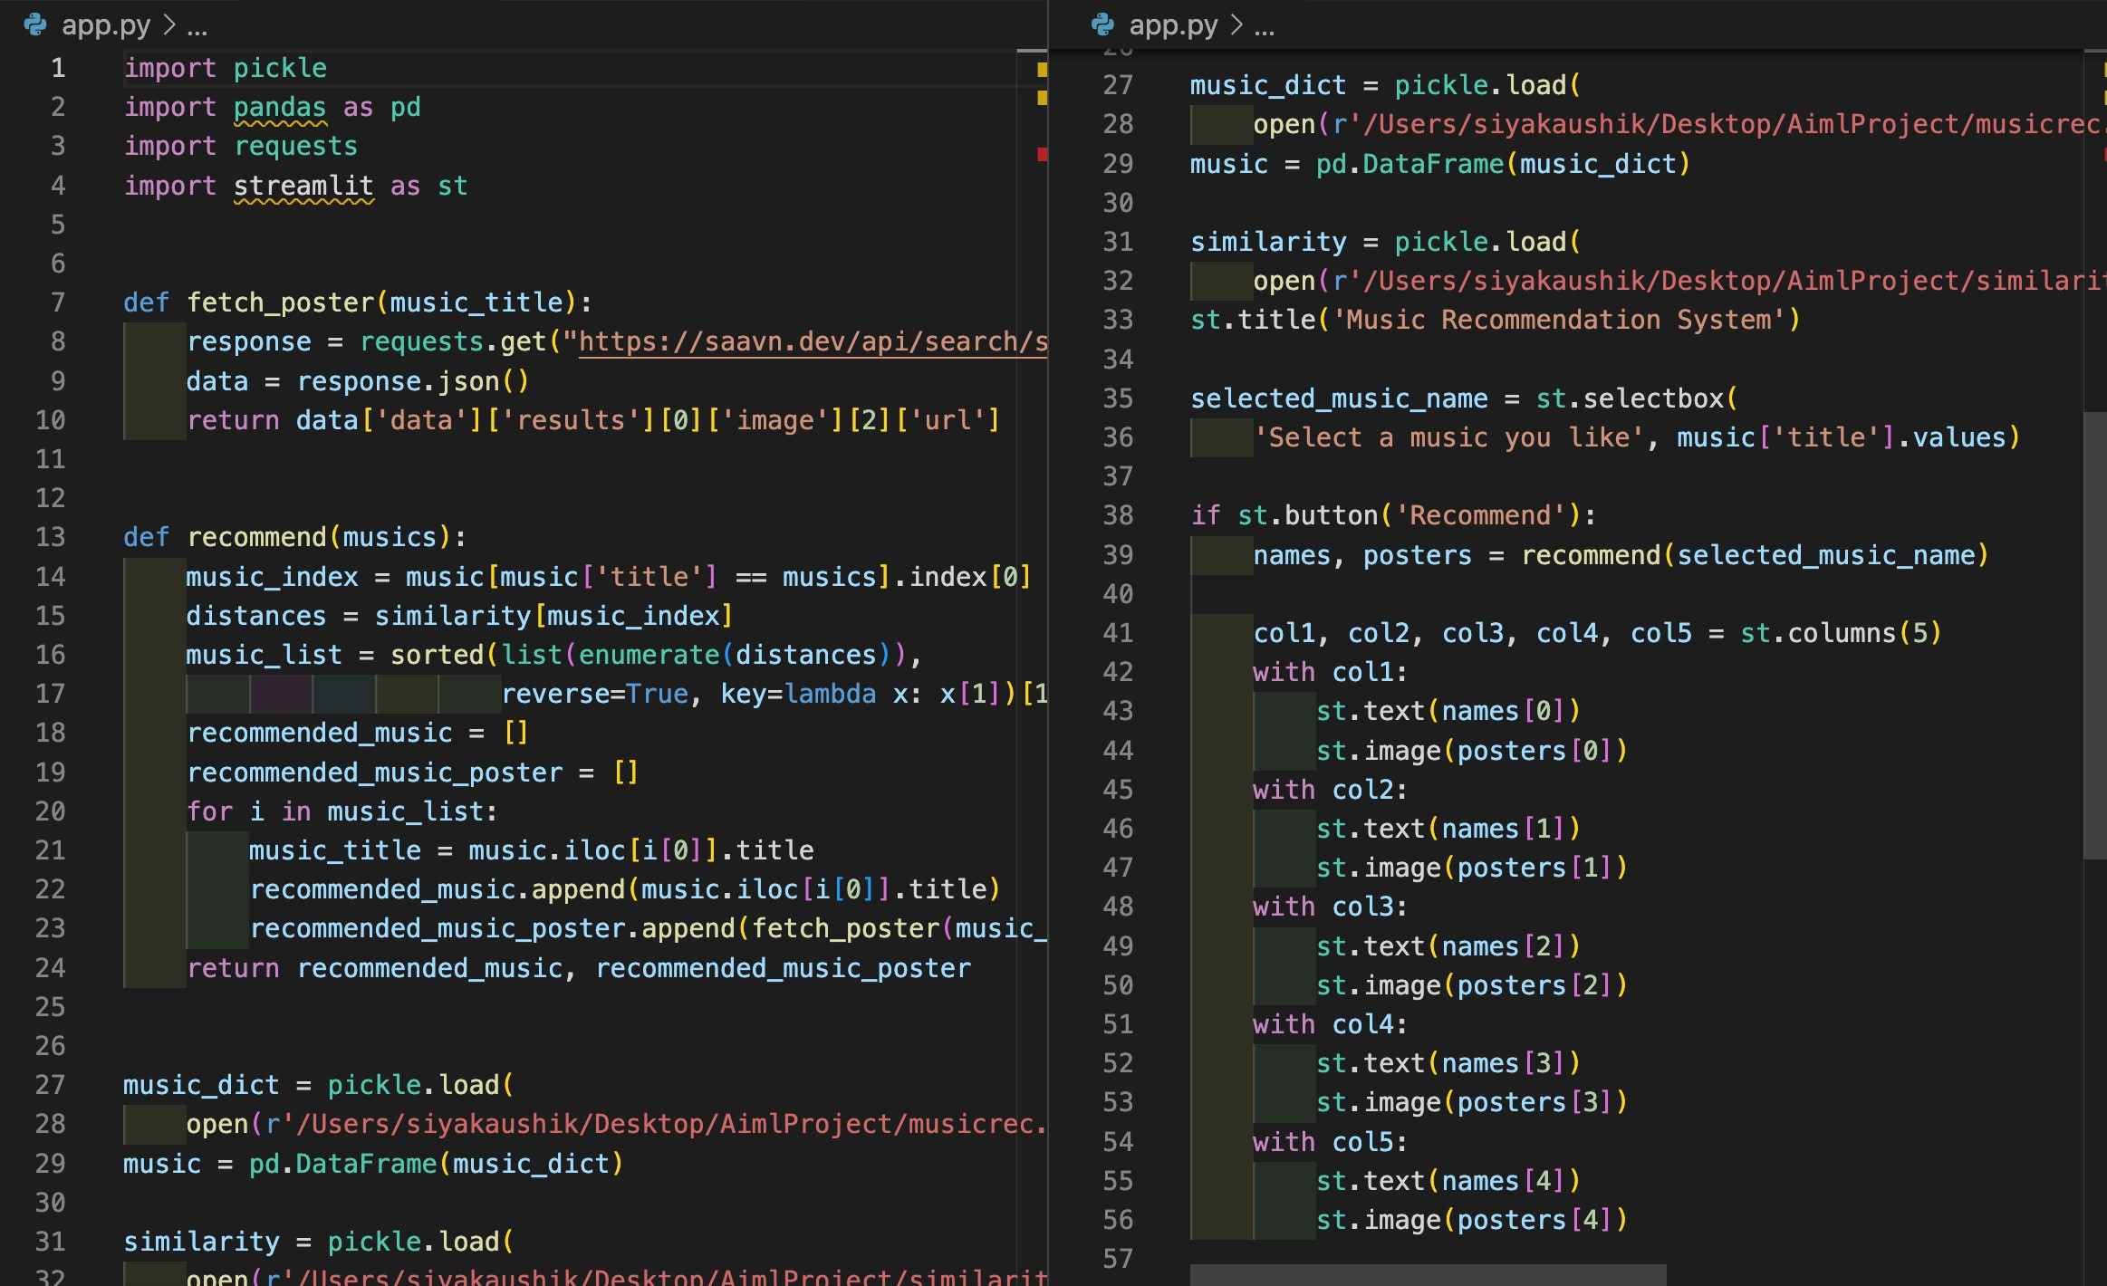
CODE SNIPPETS

Slide 6
CONCLUSION
In the realm of digital content consumption, our hybrid recommendation system combines content-based and collaborative filtering techniques to provide accurate and personalized music suggestions. Through meticulous data collection, preprocessing, and machine learning, we create a robust system capable of understanding user preferences and delivering timely recommendations, including playlist continuation. Our commitment to real-time processing, deployment, and continuous optimization ensures an enriching music listening experience, empowering users to explore and discover tailored musical journeys.

Slide 7
References
[1]Schedl, M. (2019). Deep learning in music recommendation systems. Frontiers in Applied Mathematics and Statistics, 5, 457883.
[2]Wen, X. (2021). Using deep learning approach and IoT architecture to build the intelligent music recommendation system. Soft Computing, 25(4), 3087-3096.
[3] Dataset

Slide 8
Thanks...

